Slide 1
Detecting Fraudulent Transactions Using Gradient Boosting Models and an Artificial Neural Network
Lucas Dillistone, Kevin Genereux, David Adese
Instructor: Dr. Thangarajah Akilan

Slide 2
Overview
2

Slide 3
Introduction
The rapid growth of the e-commerce industry has contributed to the exponential increase in online transactions, including fraudulent transactions.
2

Slide 4
Motivation
Manually detecting fraudulent transactions is inaccurate, inefficient, and costly.
14.4 million consumers were victims of fraudulent transactions in 2019
In 2018, $24.26 billion was lost due to payment fraud worldwide.
Large e-commerce companies have invested billions of dollars in research to detect fraudulent online activity.
2

Slide 5
Research Question and Hypothesis
Question:
Can fraudulent transactions be diagnosed/detected more accurately with the use of machine learning?
Hypothesis:
Through the use of supervised machine learning, classifiers can be trained to be effective at binary classification (fraudulent or not fraudulent).
Prediction:
2

Slide 6
Challenges
Severe class imbalance.
Fraudsters are constantly adapting their behaviour to circumvent detection systems.
Limited research is made available as e-commerce companies do not want to expose the confidentiality of their customer’s data
Significant number of features typically involved in transactional datasets.

Slide 7
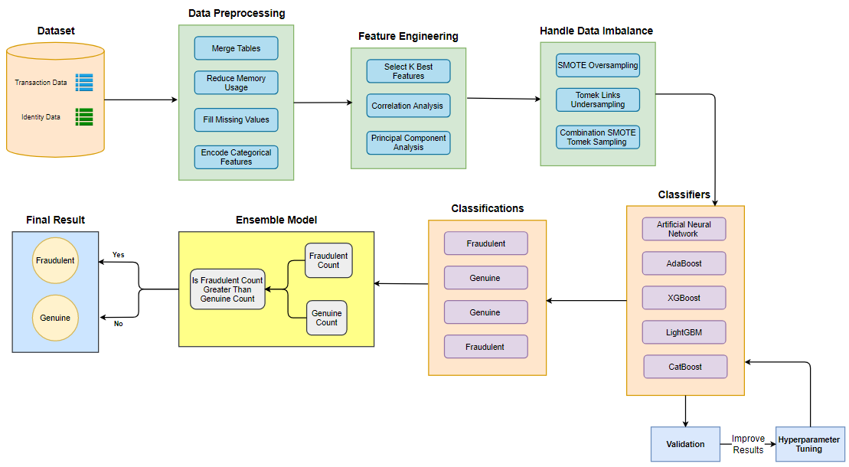
Methodology Overview
Figure 1: An overview of the project methodology.
2

Slide 8
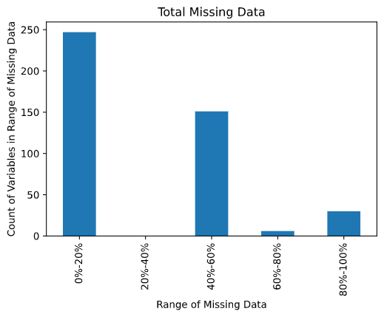
Dataset Description
Based on IEEE-CIS Fraud Detection Kaggle Competition.
Dataset acquired from Vesta Corporation partitioned into two files: transactional table (394 features) and identity table (41 features)
Transactional table contains information about each transaction:
Identity table d
Contains a mi
Fraudulent transactions consist of 3.5% of the dataset.
2

Slide 9
Transaction Table
Features | Description | Type
TransactionDT | Time delta from a given reference datetime. | numerical
TransactionAMT | Transaction payment amount in USD. | numerical
ProductCD | Product code, the product for each transaction. | categorial
Card 1 - Card 6 | Payment card information, ushc as card type, card category, issue bank, country, etc. | categorical
Addr | Address. | categorial
Dist | Distance between customer and product purchased. | numerical
P_ and (R__) email domain | Purchaser and Recipient Email Domain. | categorial
C1-C14 | Counting, such as how many addresses are found to be associated with the payment card, etc. The actual meanings are masked for confidentiality reasons. | categorical
D1-D15 | Timedelta, such as days between previous transactions for the customer, etc. | categorical
M1-M9 | Names on cards and addresses. | categorical
V1 - V339 | Vesta engineered rich features, including ranking, counting, and other entity relations. | mixed
Table 1: A summary of the features in the transaction table with a description and their data type.

Slide 10
Identity Table
Features | Description | Type
TransactionID | Transaction ID of the client. | numerical
ID1 - ID38 | Device rating, domain rating, proxy rating, login times. Lots of this information is concealed due to privacy. | numerical
DeviceType | Digital signature (browser, operating system) | categorical
DeviceInfo | Either desktop or mobile. | categorical
Table 2: A summary of the features in the transaction table with a description and their data type.

Slide 11
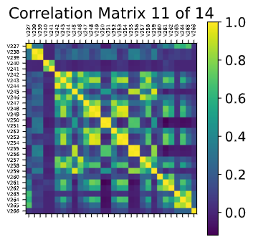
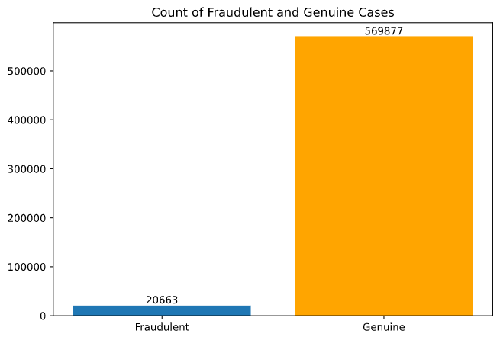
Exploratory Data Analysis
Visualizing Missing Values
Visualizing Correlation
Visualizing Data Imbalance
Figure 3: Missing data in ranges
Figure 4: A sample Correlation Matrix
2
Figure 5: Imbalanced Data

Slide 12
Methodology: Feature Engineering
SelectKBest
Correlation Analysis
Remove features that have a strong correlation to each other
These are likely redundant features that
Principal Component Analysis
2

Slide 13
Methodology: Data Preprocessing
Merge transaction and identity datasets together
Partition dataset into training (60%), validation (20%), and testing (20%) sets
Apply label encoding to convert categorical columns to numerical.
Replace missing values with the value of ‘-9999’
No normalizations techniques applied.
2

Slide 14
Handling Imbalanced Data
Resampling Technique | Type | Description
SMOTE | Oversampling | New data is created from an average of nearest neighbors of the minority class
ADASYN | Oversampling | New data is created from a weighted distribution of different minority classes
Edited Nearest Neighbours | Undersampling | Data that has been misclassified in the majority class is removed (not balanced)
One Sided Selection | Undersampling | Data on the class boundary is removed then redundant data is found and removed
Near Miss | Undersampling | A number of close majority class points are selected for every minority class point
SmoteTomek | Combination | SMOTE is initially used to oversample the minority class then data on the class boundary is removed
2

Slide 15
Methodology: Model Construction
Artificial Neural Network
Consists of multiple layers of nodes
As data is passed through nodes the weights are updated
Hidden layers can be added to increase the complexity of the network
XGBoost (Extreme Gradient Boosting)
Creates initial prediction for all observations
Calculates residuals to the actual values
Gradient boost tree is then fit to the residuals by calculating
LightGBM
Applies Gradient-based One-Side Sampling (GOSS) to filter out data instances.
Significantly faster and more memory efficient than XGBoost.

Slide 16
Methodology: Model Construction Continued
AdaBoost (Adaptive Boosting)
Considered a weak learner
Each stump is created by taking the previous stump’s mistakes into account.
Stumps are assigned weights to determine the amount of say it has
CatBoost (Categorical Boosting)
Powerful at handling datasets containing lots of categorical values
Does not requiring converting numerical columns to categorical.
Ensemble Classifier
Combines multiple models to get more accurate results
An average of the results of each model is combined

Slide 17
Methodology: Evaluation I
K-Fold Cross Validation

Slide 18





Methodology: Evaluation II
Primary Metric
AUC Score (area under an ROC Curve).
Metric used to compare performance in Kaggle competition.
Other Metrics
Accuracy, Precision, Sensitivity, Specificity, F1 Measure.
Compare to related research papers.
Metric | Formula | Description
Accuracy |  | Proportion of correct transaction predictions to total number of transactions.
Precision |  | Proportion of transactions correctly predicted to be fraudulent to transactions predicted to be fraudulent .
Sensitivity |  | Proportion of transactions correctly predicted to be fraudulent to transactions that are fraudulent.
Specificity |  | Proportion of transactions correctly predicted to not have melanoma to patients diagnosed without melanoma.
F1 Measure |  | Harmonic mean between precision and recall.
Table 1: Model metrics for accuracy, precision, sensitivity, specificity,
and F1 measure.

Slide 19
Application Areas
Manually detecting fraudulent transactions is inaccurate, inefficient, and costly.
In 2019, 14.4 million consumers were victims of fraudulent credit card transactions.
Fraudulent transactions may cause e-commerce companies decrease in revenues, legal repercussions, and a loss of reputation.

Slide 20
Future Directions
Integrate multiple databases containing transactional data.
Modify classifiers to implement unsupervised learning rather than supervised learning.
Explore various feature selection strategies

Slide 21
Works Cited
https://machinelearningmastery.com/undersampling-algorithms-for-imbalanced-classification/

